Slide 1
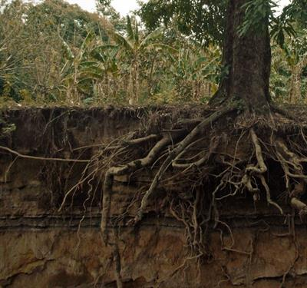
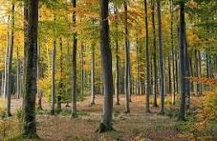

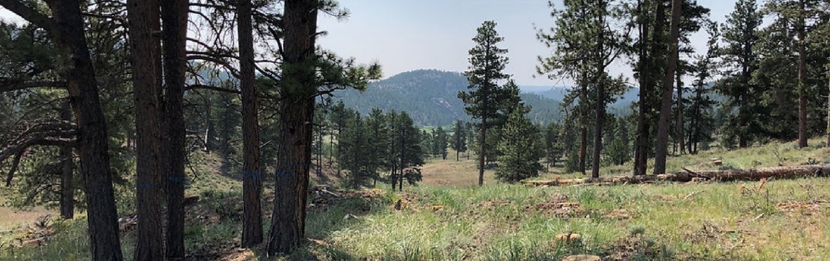
Module 1: Principles of Forestland Soil Health
Notes:
Forestland Soil Health is just as important as the soil health of other land uses. Perhaps even more so since the vegetation needs to be in place for decades and even centuries. Through this module, we will discuss how the 4 principles of soil health fit into the forest systems.

Slide 2
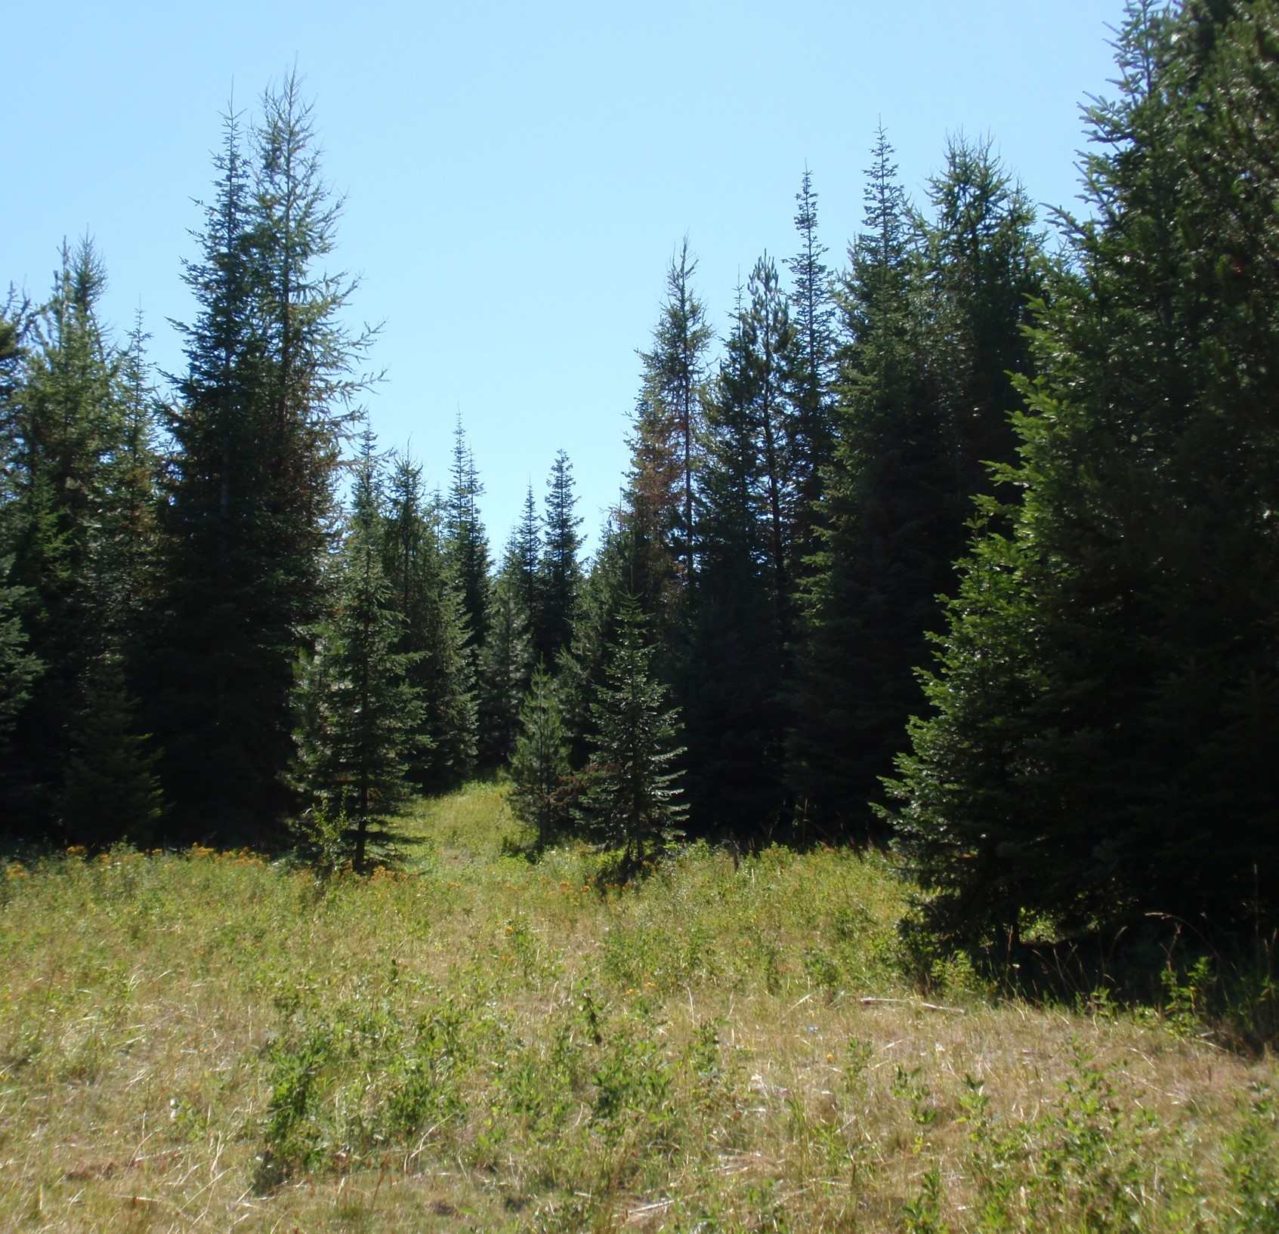
Objectives
Describe forest soils in terms of healthy functioning systems.
Identify biotic and abiotic components of forest ecosystems.
List and explain the soil health principle's role in forest systems.
Introduce traditional ecological knowledge (TEK) and local ecological knowledge (LEK).
N. Sirovatka

Slide 3
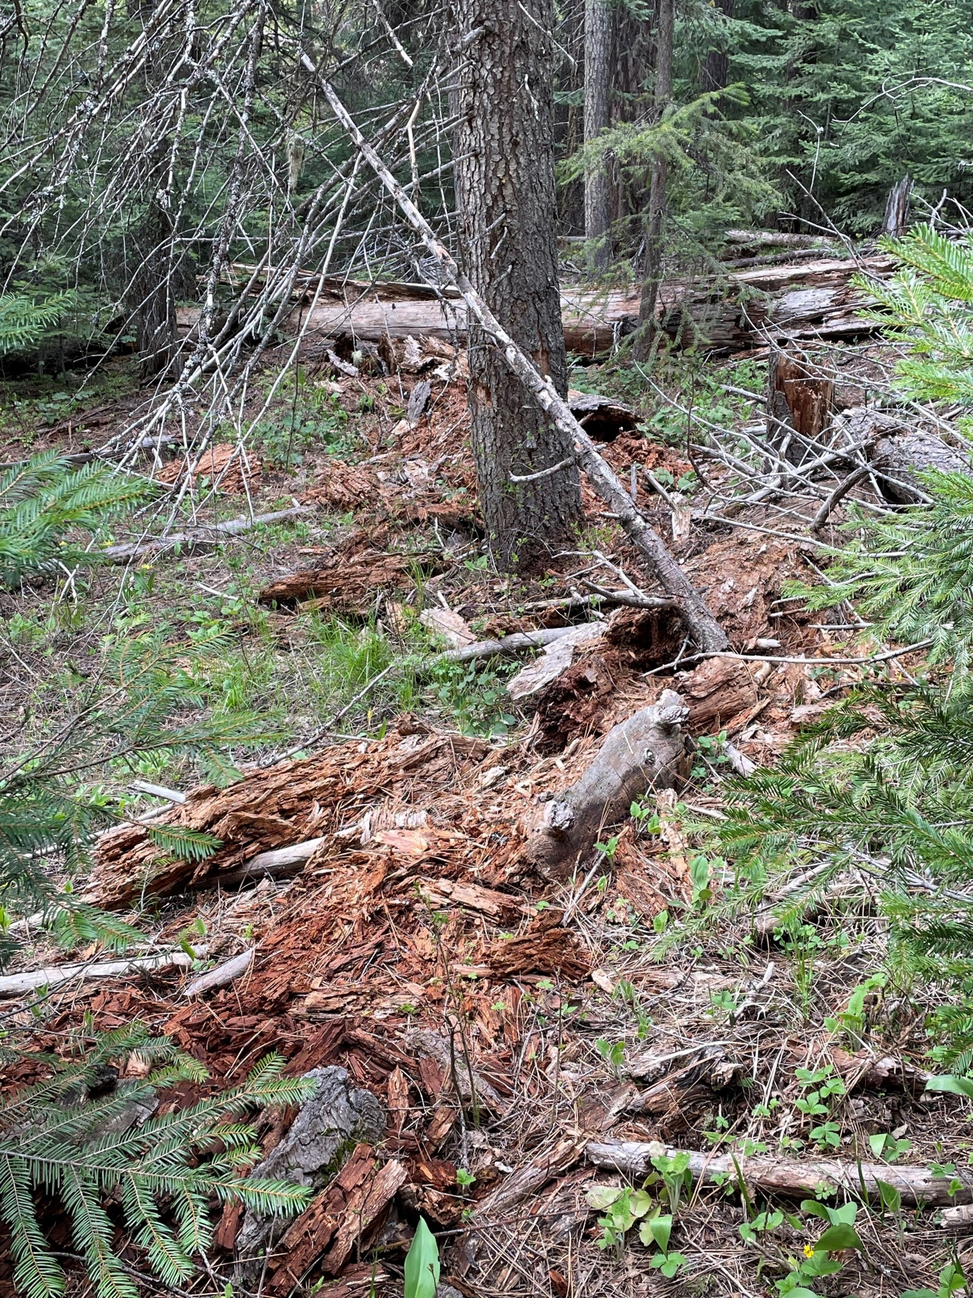
Working Definition of Forest Soil Health
NRCS Definition: The continued capacity of the soil to function as a vital living ecosystem that sustains plants, animal and humans.
Forest soil health also includes a capacity for water retention, carbon (C) sequestration, and plant productivity.
OR
It could simply be defined as the ability of the soil to produce biomass.
(Schoenholtz et al., 2000)
N. Sirovatka
Notes:
Page-Dumroese, Deborah S. et al; Soil Health Assessment of Forest Soils. Soil Health Series Volume 1 Approaches to Soil Health Analysis. 2021 Soil Science Society of America, Inc.
Class Discussion: How would the class participants change this definition??
The U.S. Department of Agriculture (USDA) Forest Service requirement to leave 25 to 27 tons ha-1 of coarse woody material greater than 14 cm in diameter. comes from the need to provide ‘parent material’ for decayed wood in many forest ecosystems (Harvey et al., 1981) and ensure a healthy population of ectomycorrhizal fungi.

Slide 4
What types of forest are we dealing with?
Three broad categories
Tropical Temperate Boreal
Moist
Dry
Cloud
Mangroves
Deciduous
Coniferous
Temperate Rainforest
Open Canopy
Closed Canopy
Notes:
Most of our Planners will be working in the Temperate forests of the United States
Boreal forests are located between 50 and 60o North are really cold (as low as -30 oC). Around 80% of these forests grow in ground which stays frozen all year round (called permafrost).
Temperate: As these forests are found in mid-latitudes, they have four seasons – their tell-tale characteristic. Each season (and location) comes with different conditions. Temperatures can range from -30oC – 30oC while the forests’ precipitation averages range from around 75cm to 1.5m per year. This means the plants and animals in these forests deal with a variety of conditions, but as the soils are generally very nutrient rich, there’s a lot of growth.
Tropical forests occur between the tropics of Cancer and Capricorn and so offer stable conditions. They are the warmest (20C to 30C) and wettest forests on the planet. Tropical forests are also some of the most species rich ecosystems on Earth; even though they cover less than 10% of the world they host over half the species. Because of all the different plants and animals in these forests any nutrients are used up quickly, meaning the soils are extremely poor.
Wilkinson, E. Operation Wallacea | The Different Types of Forest (opwall.com)

Slide 5

Soil Basics: What characteristics do we expect to see in a common forest soil?
Rocky/Shallow
Hardpan/fragipan
Steep, often dissected terrain
Wet, or dry
Lower fertility
Unfavorable climate
Degraded
Trees
Variable
Notes:
Padley, E. “Managing Soil Quality in Forests” 2016- Natural Resources Conservation Service Presentation Slide deck.

Slide 6
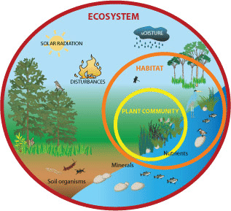
Area wide approach vs.
Localized approach
Forest Soil Health needs to account for both
Biotic & Abiotic Factors
USFWS
Notes:
Credit: Courtesy of US Fish and Wildlife Service
Source: http://www.fws.gov/invasives/volunteersTrainingModule/invasives/plants.html
License: Public Domain
The disturbances that we create in the upland will have affects on the lowlands.

Slide 7
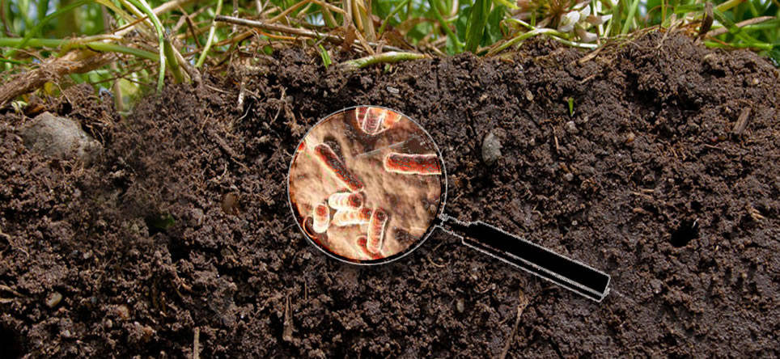
What are the biotic components of a forest ecosystem?
Producer Organisms - Plants
Consumer Organisms - Animals
Decomposers - Our wheelhouse - bacteria and fungi
Saunders Hardscape
What are the abiotic components of a forest ecosystem?
Notes:
From a 30,000 ft view the biotic components of a forest ecosystem can be grouped into:
Producer Organisms- Plants
Consumer Organisms- Animals
Decomposers- Our wheelhouse- bacteria and fungi

Slide 8
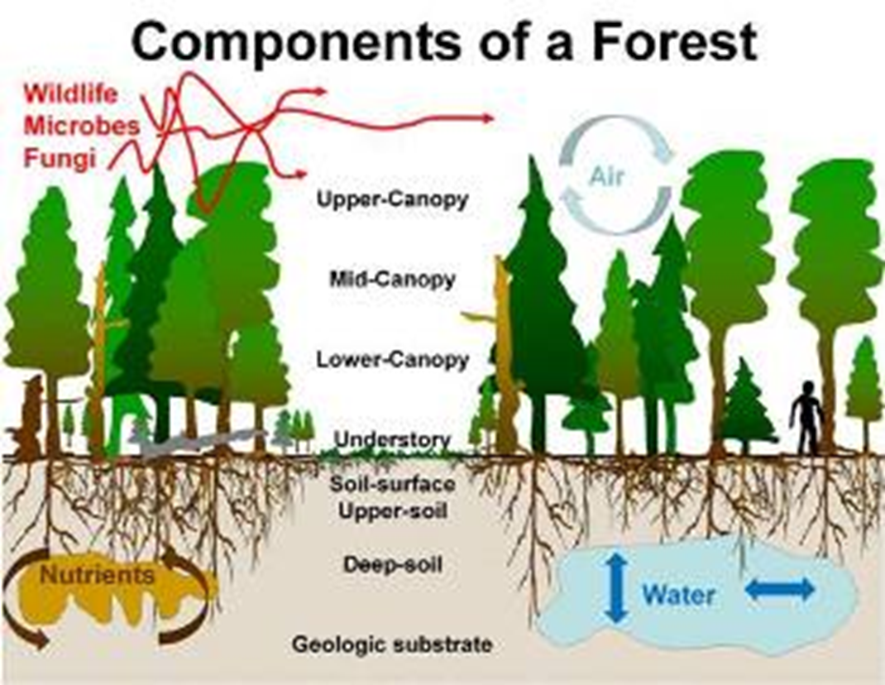
Illustration Credit: Peter Kolb, University of Montana
Notes:
Forest Ecosystems – Climate, Forests and Woodlands (extension.org)

Slide 9
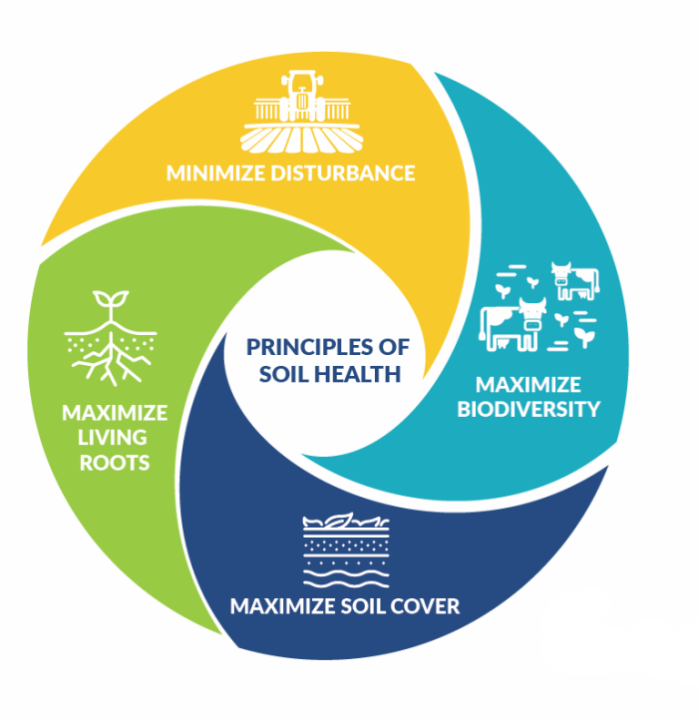
Principles that Conserve the Soil Ecosystem
Minimize Disturbance
Maximize Cover
Maximize Biodiversity
Maximize Continuous Living Roots
Notes:
The soil health principles being advocated by NRCS are essentially attempting to mimic what is typically occurring in native ecosystems.
Minimizing soil disturbance, whether that is physical (roads, landings, skidders), chemical (excessive nutrients or pesticides) or biological (creating favorable conditions for diseases or weeds). Recognize that some, managed disturbance may be desirable. That should be managed to a minimum that meets the management objectives.
Maximize cover of the soil with living or dead plant material.
Maximize the diversity of the system. Fundamentally, this will be introducing greater temporal and spatial diversity with plants and adding grazing animals to the cropping system would be another means of increasing diversity in the system.
Maximize the time and distribution of living roots in the soil. This will be in large part dependent on climate and cropping system. Understand that the goal is have growing plants for as much of the year as practicable.
Magdoff expansion of principles (MAGDOFF, FRED.2021. Repairing the Soil Carbon Rift. Monthly review (New York, N.Y.: 1949).https://dx.doi.org/10.14452/MR-072-11-2021-04_1. )
Keeping the soil covered with living vegetation (and living roots in the ground) for as much of the year as possible.
Reducing soil disturbance using appropriate equipment, and timing of operations.
Integrate animals into grazing systems.

Slide 10
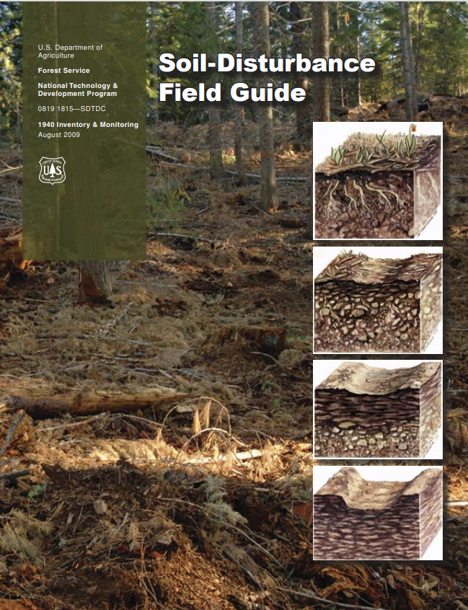
Soil Health Principle
Minimize Disturbance
--Soil Disturbance Class Attributes--
Forest-Floor Attributes:
• Forest-floor impacted.
• Live plant.
• Fine woody.
• Coarse woody.
• Bare soil.
• Rock.
Surface-Soil Attributes:
• Topsoil displacement.
• Erosion.
• Ruts – shallow.
• Ruts – moderate.
• Ruts – deep.
• Puddled conditions.
• Burning – low severity.
• Burning – moderate severity.
• Burning – high severity.
Subsurface Attributes:
• Compaction – shallow.
• Compaction – moderate.
• Compaction – deep.
• Platy structure.
• Massive structure.
Notes:
SD_FG_8-19-09.indd (usda.gov)
list of attributes is from the National Soil Disturbance Monitoring Protocol, volume 2, included in appendix A (pg 7)
As we progress in this course, you will see that the forest floor attributes listed will tie into the NRCS Forest In-Field Soil Health Assessment. We also will look at the surface-soil attributes throughout the modules, but as soil health professionals- you should note that soil displacement/erosion, ruts, and puddled conditions all have negative effects on soil health. The sub surface attributes tie directly into SH resource concerns that we see across all land uses.

Slide 11
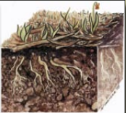
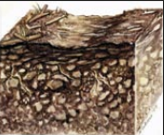
USFS Soil Disturbance Classes
Soil-disturbance Class 0 – Undisturbed
No evidence of past equipment.
No depressions or wheel tracks.
Forest-floor layers are present and intact.
No soil displacement evident.
No management-generated soil erosion.
No management-created soil compaction.
No management-created platy soils.
Soil-Disturbance Class 1
Wheel tracks or depressions evident, but faint and shallow.
Forest-floor layers are present and intact.
Surface soil has not been displaced.
Soil burn severity from prescribed fires is low (slight charring of vegetation, discontinuous).
Soil compaction is shallow (0 to 4 inches).
Soil structure is changed from undisturbed conditions to platy or massive albeit discontinuous.
Class and graphic credit: USFS
Soil Disturbance Field Guide
Notes:
Our partner agency (US Forest Service) utilizes the above ratings and points to evaluate when they look at the forest floor. The NRCS Soil Health Division's FIFSA goes a bit deeper than this evaluation does, but there are some similarities. Equipment tracks, management created soil compaction/platy soils all lead to potential resource concerns for soil health, and by being aware of how what you observe on the forest floor can affect the soil below, you can make your evaluation that much smoother.
For more information: (PRESENTER CAN SHARE THE LINK IF PARTICIPANTS ARE INTERESETED)
SD_FG_8-19-09.indd (usda.gov)
CLASS 0:
The soil-disturbance class 0 is defined by the following characteristics: • No evidence of past equipment. • No depressions or wheel tracks. • Forest-floor layers are present and intact. • No soil-displacement evident. • No management-generated soil erosion. • No management-created soil compaction. • No management-created platy soil
CLASS 1:
Soil surface: • Faint wheel tracks or slight depressions evident. • Forest-floor layers present and intact. • Surface soil has not been displaced and shows minimal mixing with subsoil. • Low soil burn severity. Litter slightly charred or partially consumed. Duff largely intact. Water repellency is similar to pre-burn conditions. • Soil compaction is shallow. [Compaction in the surface soil (top 0 to 4 inches) is slightly greater than observed under natural conditions.]
Soil physical conditions: • Change in soil structure from granular structure to massive or platy structure; restricted to the surface soil. • Platy structure is noncontinuous.

Slide 12
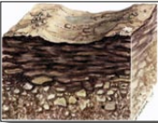
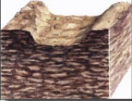
USFS Soil Disturbance Classes
Soil Disturbance Class 2
Wheel tracks or depressions are evident and moderately deep.
Forest-floor layers are partially missing.
Surface soil partially intact and maybe mixed with subsoil.
Soil burn severity from prescribed fires is moderate (black ash evident and water repellency may be increased compared to pre-burn condition).
Soil compaction is moderately deep (up to 12 inches).
Soil structure is changed from undisturbed conditions and may be platy or massive.
Soil Disturbance Class 3
Wheel tracks or depressions are evident and deep.
Forest-floor layers are missing.
Surface soil is removed through gouging or piling.
Surface soil is displaced.
Soil burn severity from prescribed fires is high (white or reddish ash, all litter completely consumed, and soil structureless).
Soil compaction is persistent and deep (greater than 12 inches).
Soil structure is changed from undisturbed and is platy or massive throughout.
Class and graphic credit: USFS
Soil Disturbance Field Guide
Notes:
As the severity ratings increase, we continue to see that surface level observations can help diagnose the potential for increasing issues for soil health and resource concerns that NRCS can address with the producer. In all of these disturbance class ratings, we are using visual observations to give us indicators. However, the FIFSHA will help tie together the observations and evaluations in-field with practices that we can implement to solve those associated resource concerns.
SD_FG_8-19-09.indd (usda.gov)
CLASS 2:
Soil surface: • Wheel tracks or depressions are evident in the mineral soil. • Forest-floor layers partially intact or missing. • Surface soil partially intact and may be mixed with subsoil. • Moderate soil burn severity. o Surface soil-water repellency increased compared to the pre-burn conditions. o Black ash with the majority of the fuel consumed. • Soil compaction is present in the mineral soil (down to about 12 inches).
Observations of soil physical condition: • Change in soil structure from granular to platy. • Platy structure is generally continuous. o Large roots may penetrate the platy structure; but fine and medium roots may not
CLASS 3:
Soil surface: • Wheel tracks and depressions highly evident. • Forest-floor layers are missing. • Evidence of surface soil removal, gouging, and piling. • The majority of surface soil has been displaced. Surface soil may be mixed with subsoil. Subsoil partially or totally exposed. • High soil burn severity has the duff and litter layer completely consumed. The surface soil color may be reddish or orange in places and the surface soil is water repellent. • Soil compaction is deep in the soil profile (greater than 12 inches in depth).
Observations of soil physical conditions: • Change in soil structure from granular structure to massive or platy structure greater than 12 inches in depth. • Platy structure is continuous and roots do not penetrate the platy structure

Slide 13
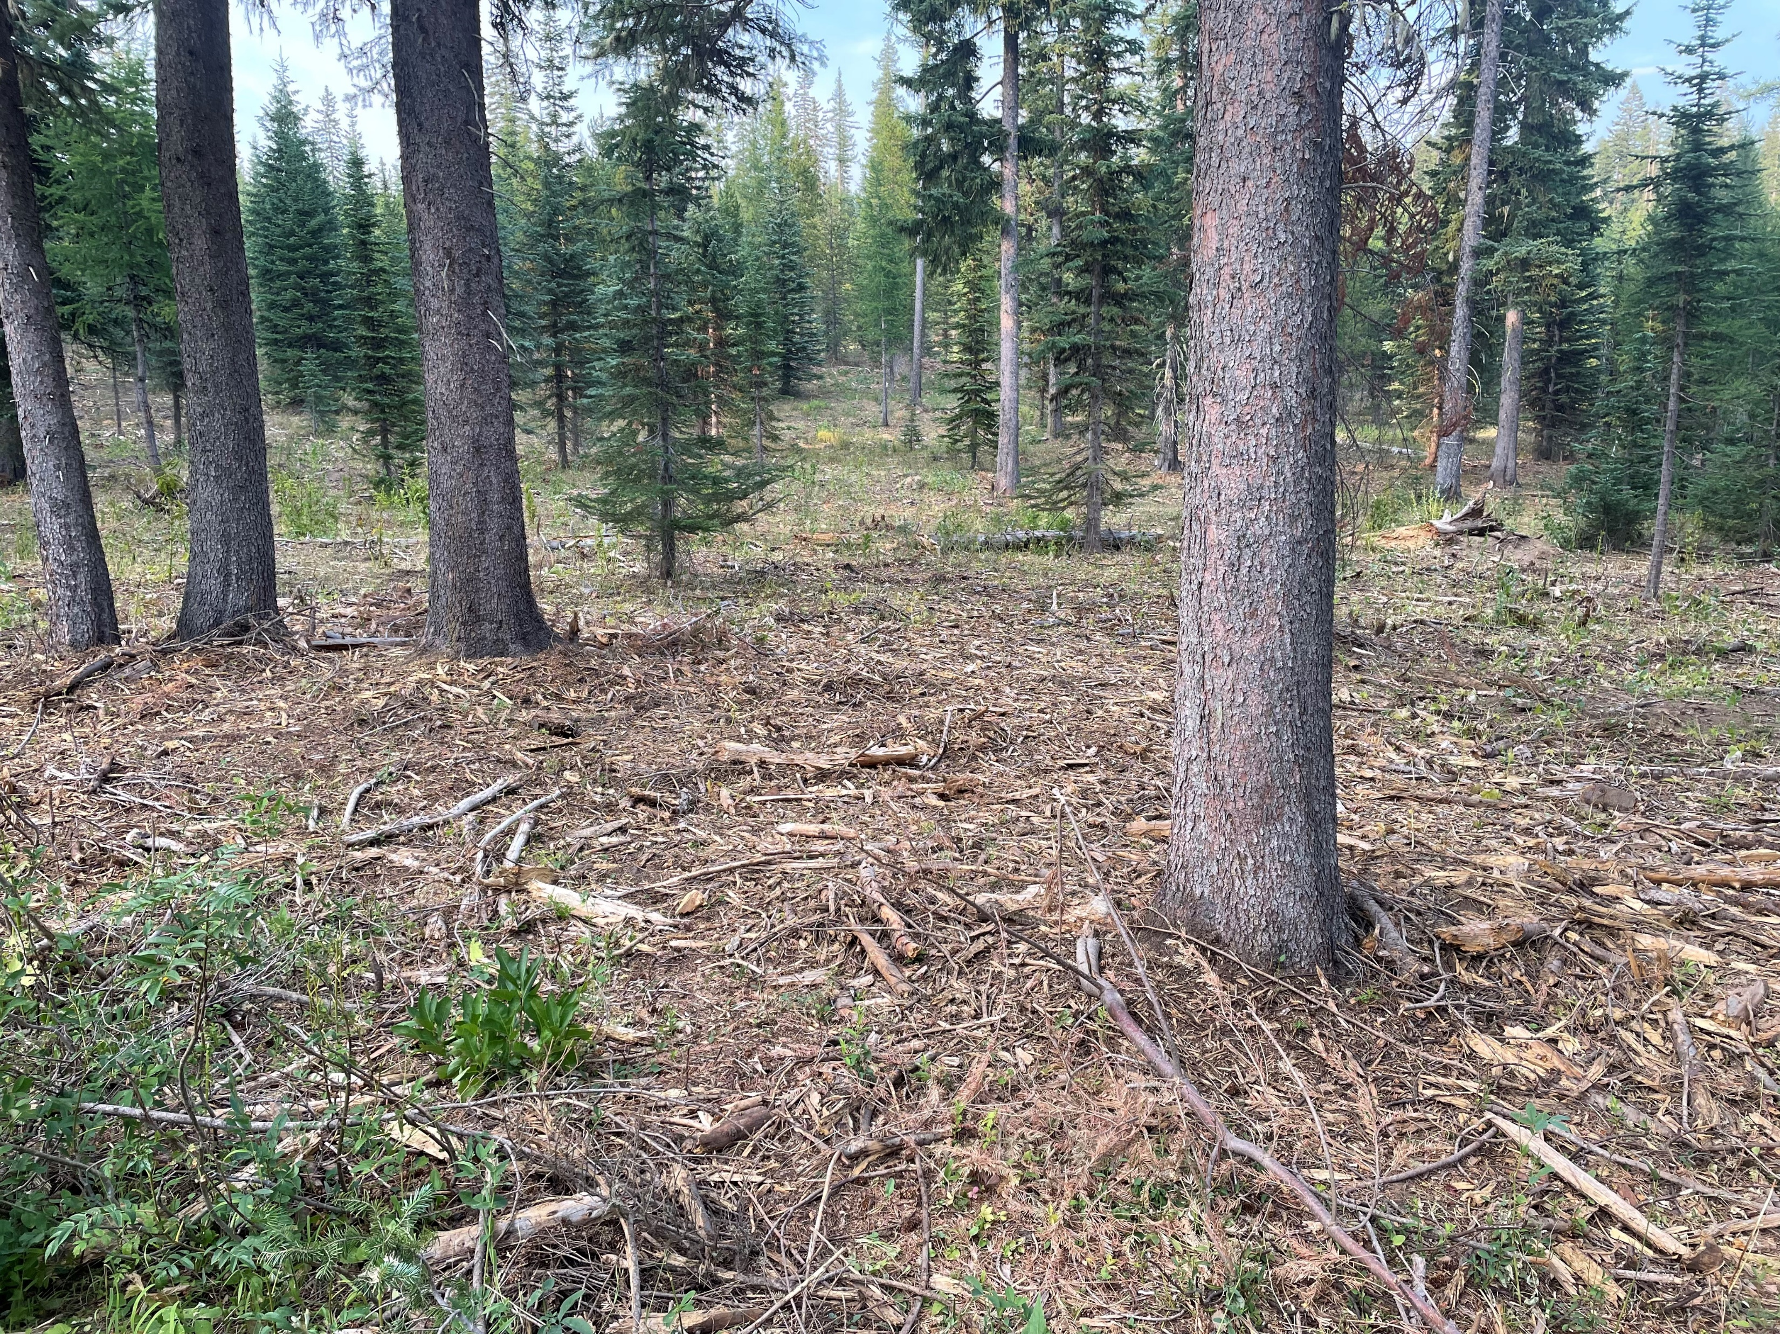
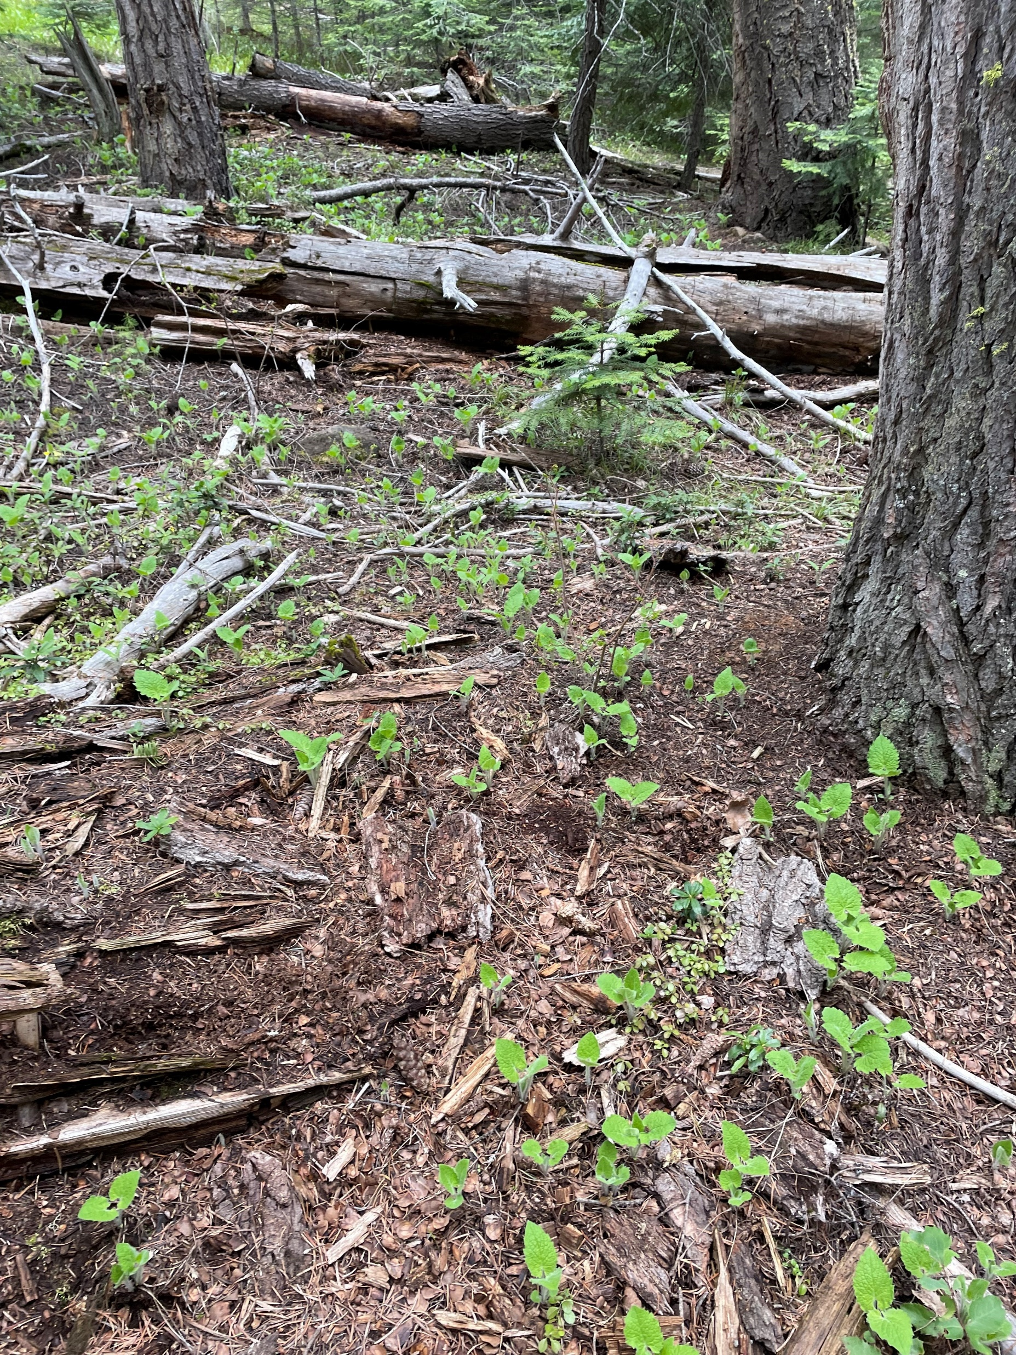
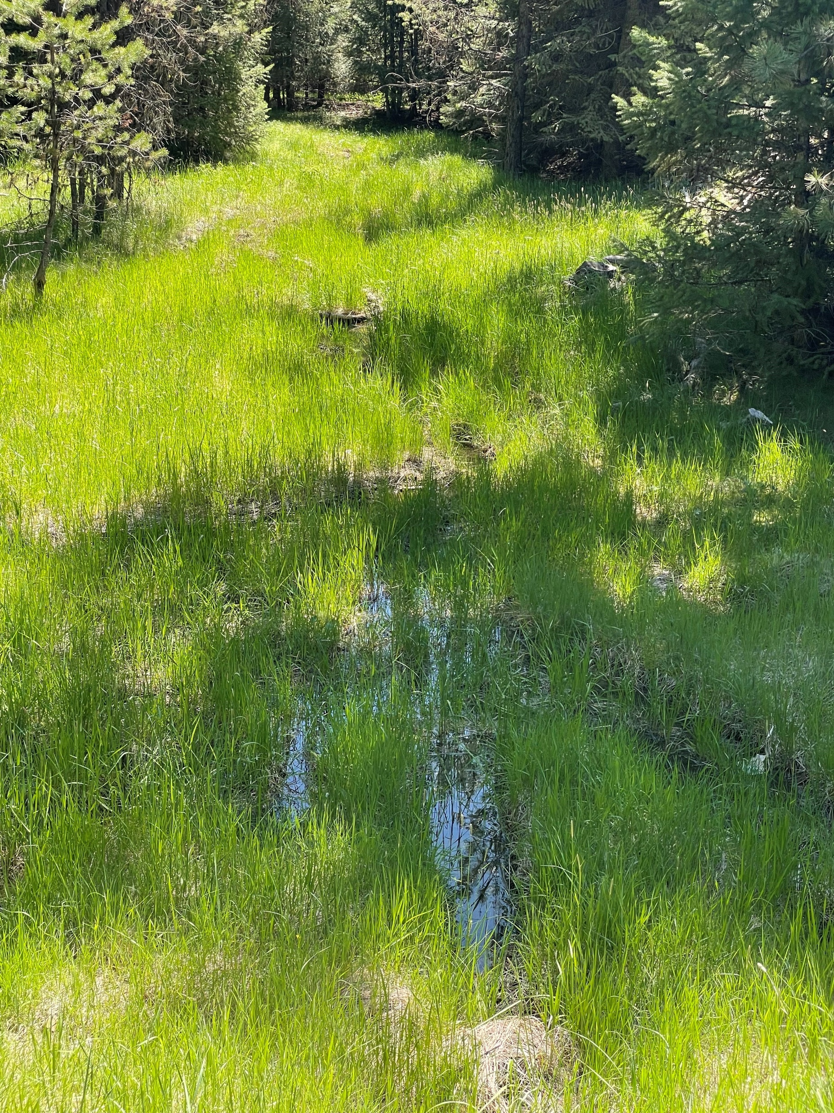
Soil Health Principle
Maximize Cover
Bare or mineral soil exposed in forests are at risk of decreased microbial activity.
Changing cover amounts and types can affect multiple abiotic characteristics of a forest as well
Notes:
All photos this slide: credit N. Sirovatka USDA-NRCS
Decrease Erosion Potentials
Increase Infiltration Potentials
Decrease Evaporation Potentials
Moderate Soil Temperatures
Increase Habitat for Soil Organisms
Provide food sources for soil biota
Change in cover amount and types can change how water infiltrates into a soil; potentially leading to erosion (surface runoff) but also can affect interflow and groundwater flow

Slide 14
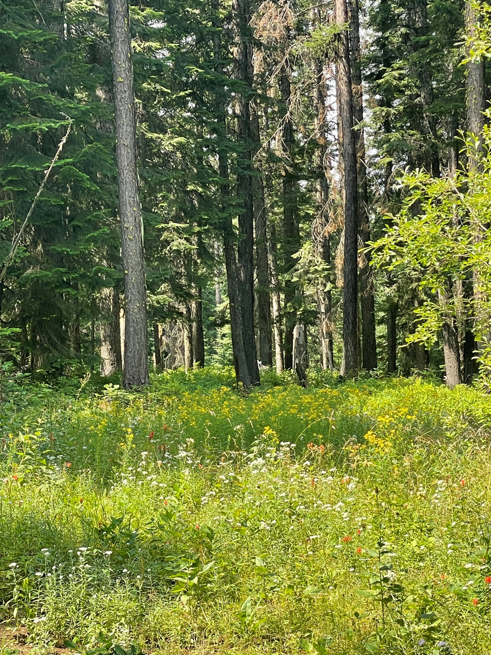
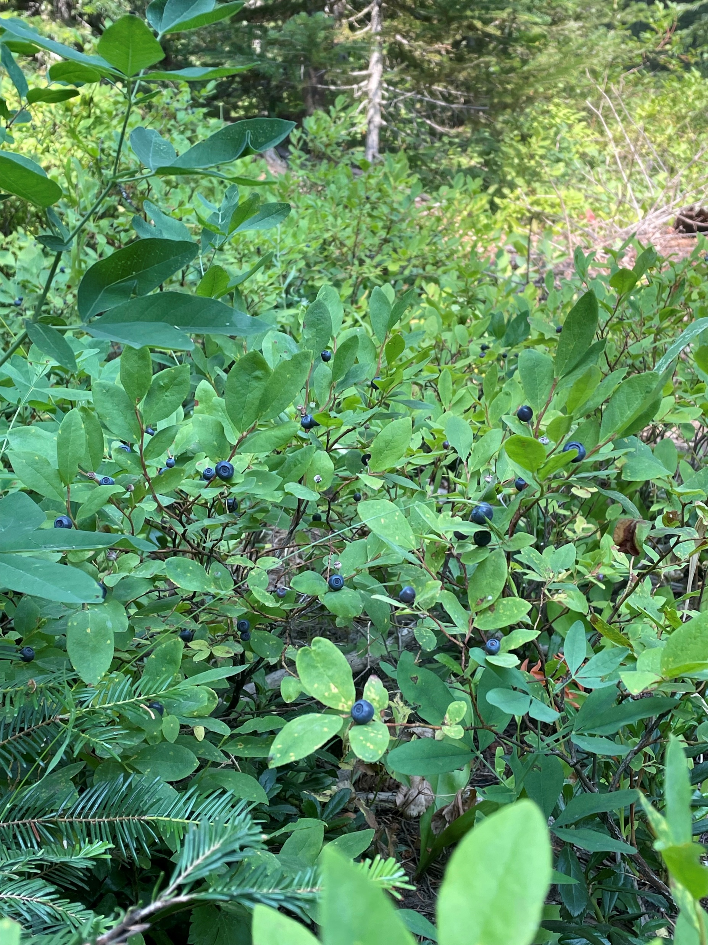
Soil Health Principle
Maximize Biodiversity
Appropriate management of our forest resources not only benefit our soil environment but also our above ground biodiversity.
Forests contain 60,000 different tree species,
80 percent of amphibian species,
75 percent of bird species,
68 percent of the world's mammal species.
(2020 State of the World’s Forests Report)
Forest soil biodiversity is complex- but the service the soil environment provides is vital to human health.
Notes:
Photo credit this slide: N. Sirovatka USDA-NRCS
The State of the World’s Forests 2020 (fao.org)
Forest ecosystems function because the entire ecosystem is functioning. The above ground and the below ground.
Below ground biotic populations are driving nutrient cycles, water cycles, carbon sequestration and plant health cycles.
The trees and the understory provide vital services to the systems health. Change or destroy one and there is a risk that other levels will be affected

Slide 15
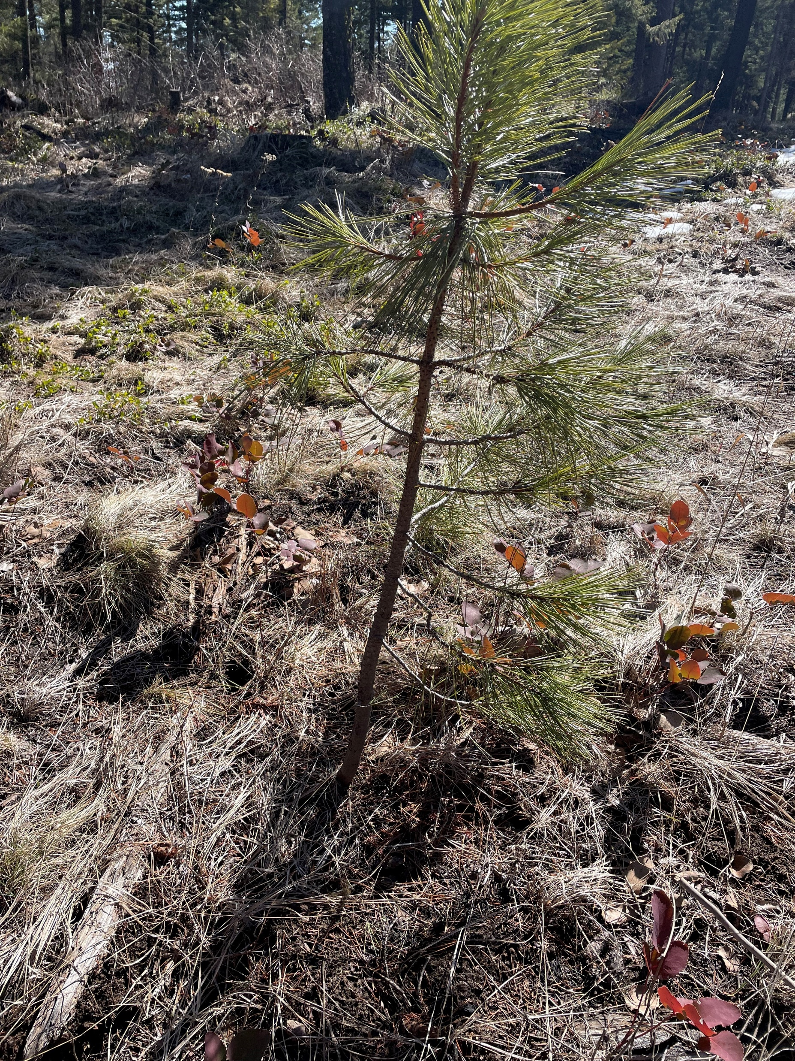
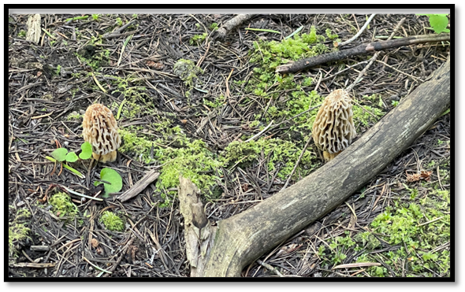
Soil Health Principle
Maximize Living Roots
Living roots drive the belowground ecosystem
Carbon transport helps feed the underground food web
Other root exudates along with carbon help attract microbial populations that contribute to the soil organic matter (SOM) levels.
Living roots help hold the soil in place- if it’s not where it’s supposed to be, it doesn’t provide the intended benefits.
Notes:
Photo credit this slide: N. Sirovatka USDA-NRCS

Slide 16
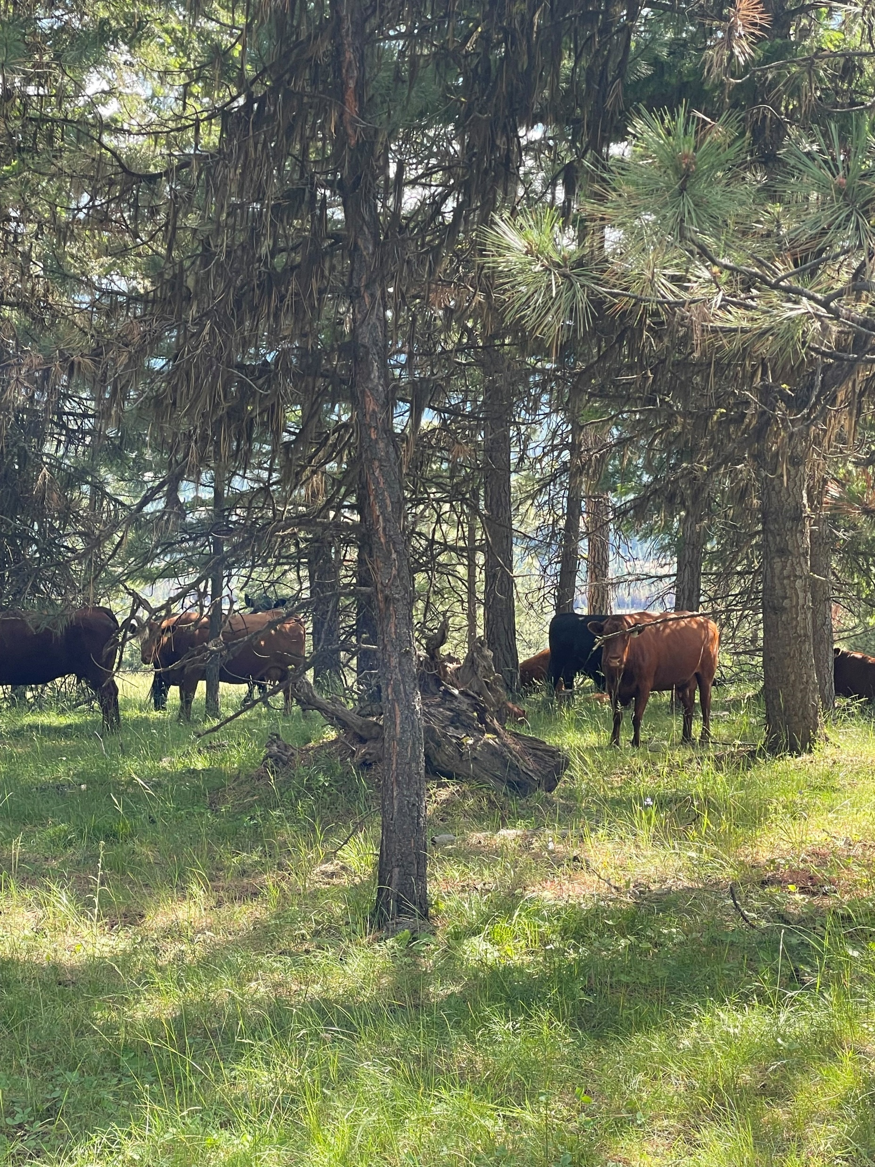

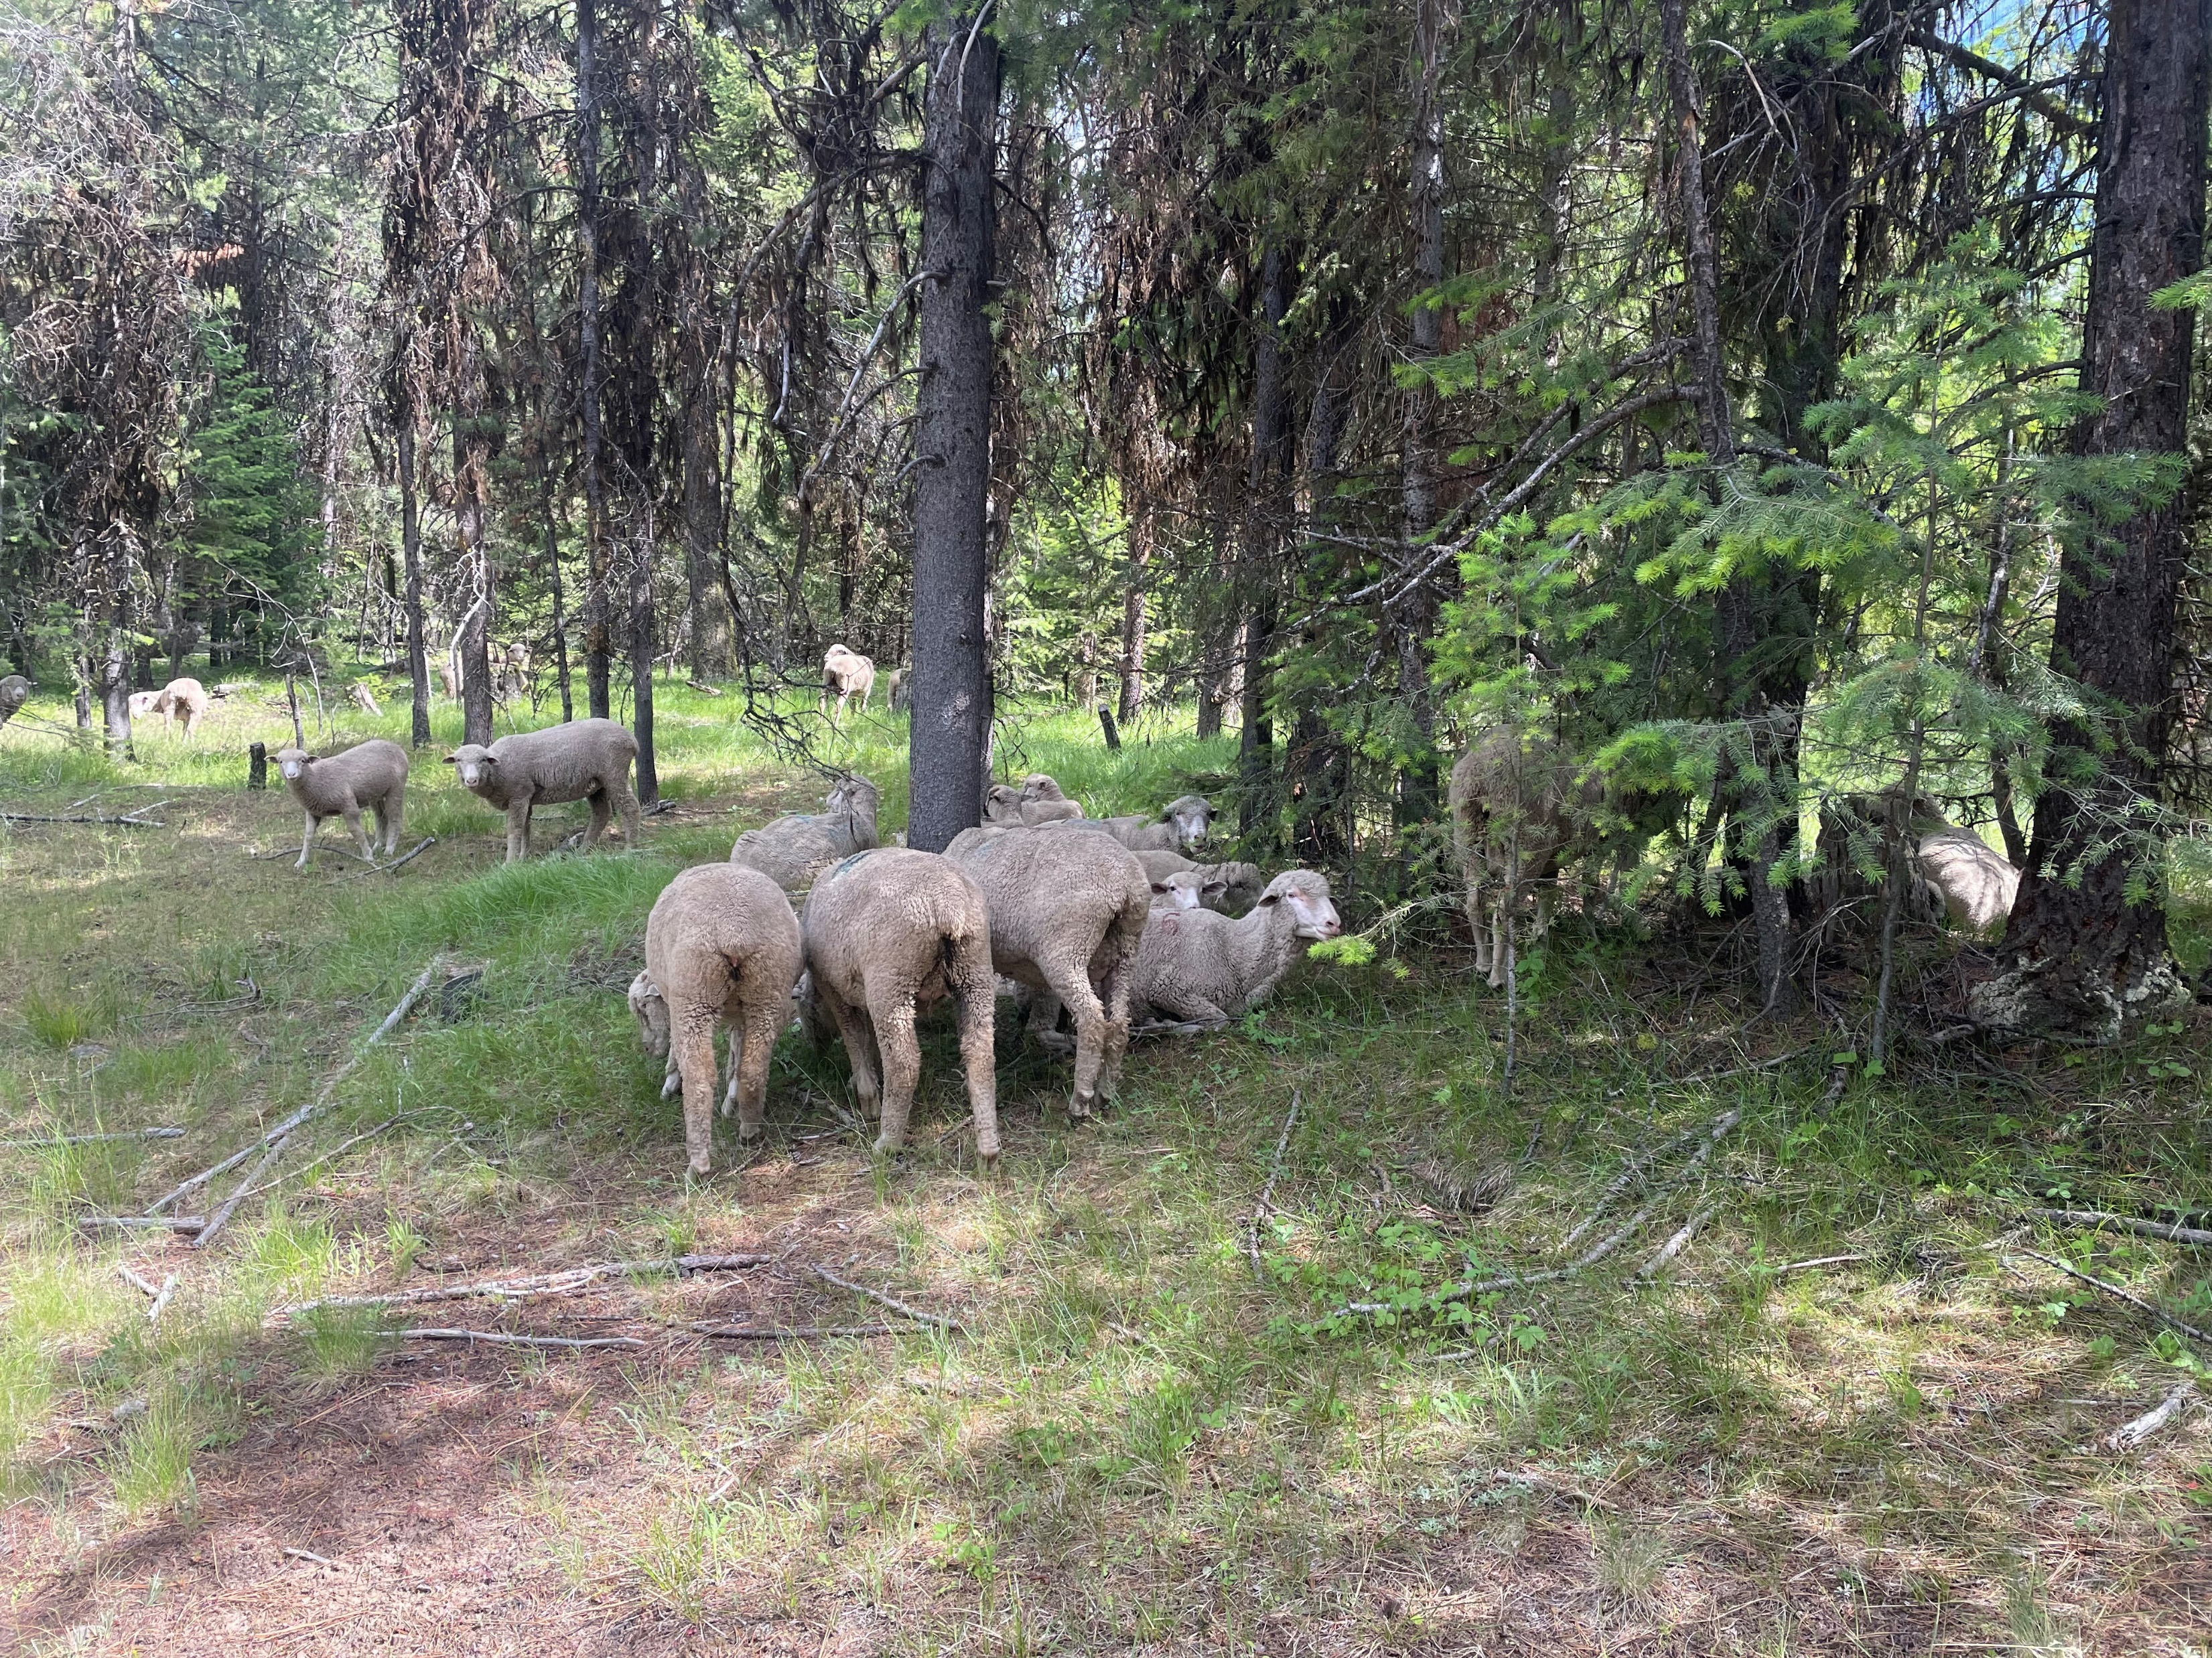
Soil Health Benefit
Introduce Livestock Diversity
Forests, especially in the western U.S. are utilized by livestock producers for summer pasture. This provides a positive benefit for producers and animals alike.
Notes:
Photo Credit this slide: N. Sirovatka USDA-NRCS

Slide 17
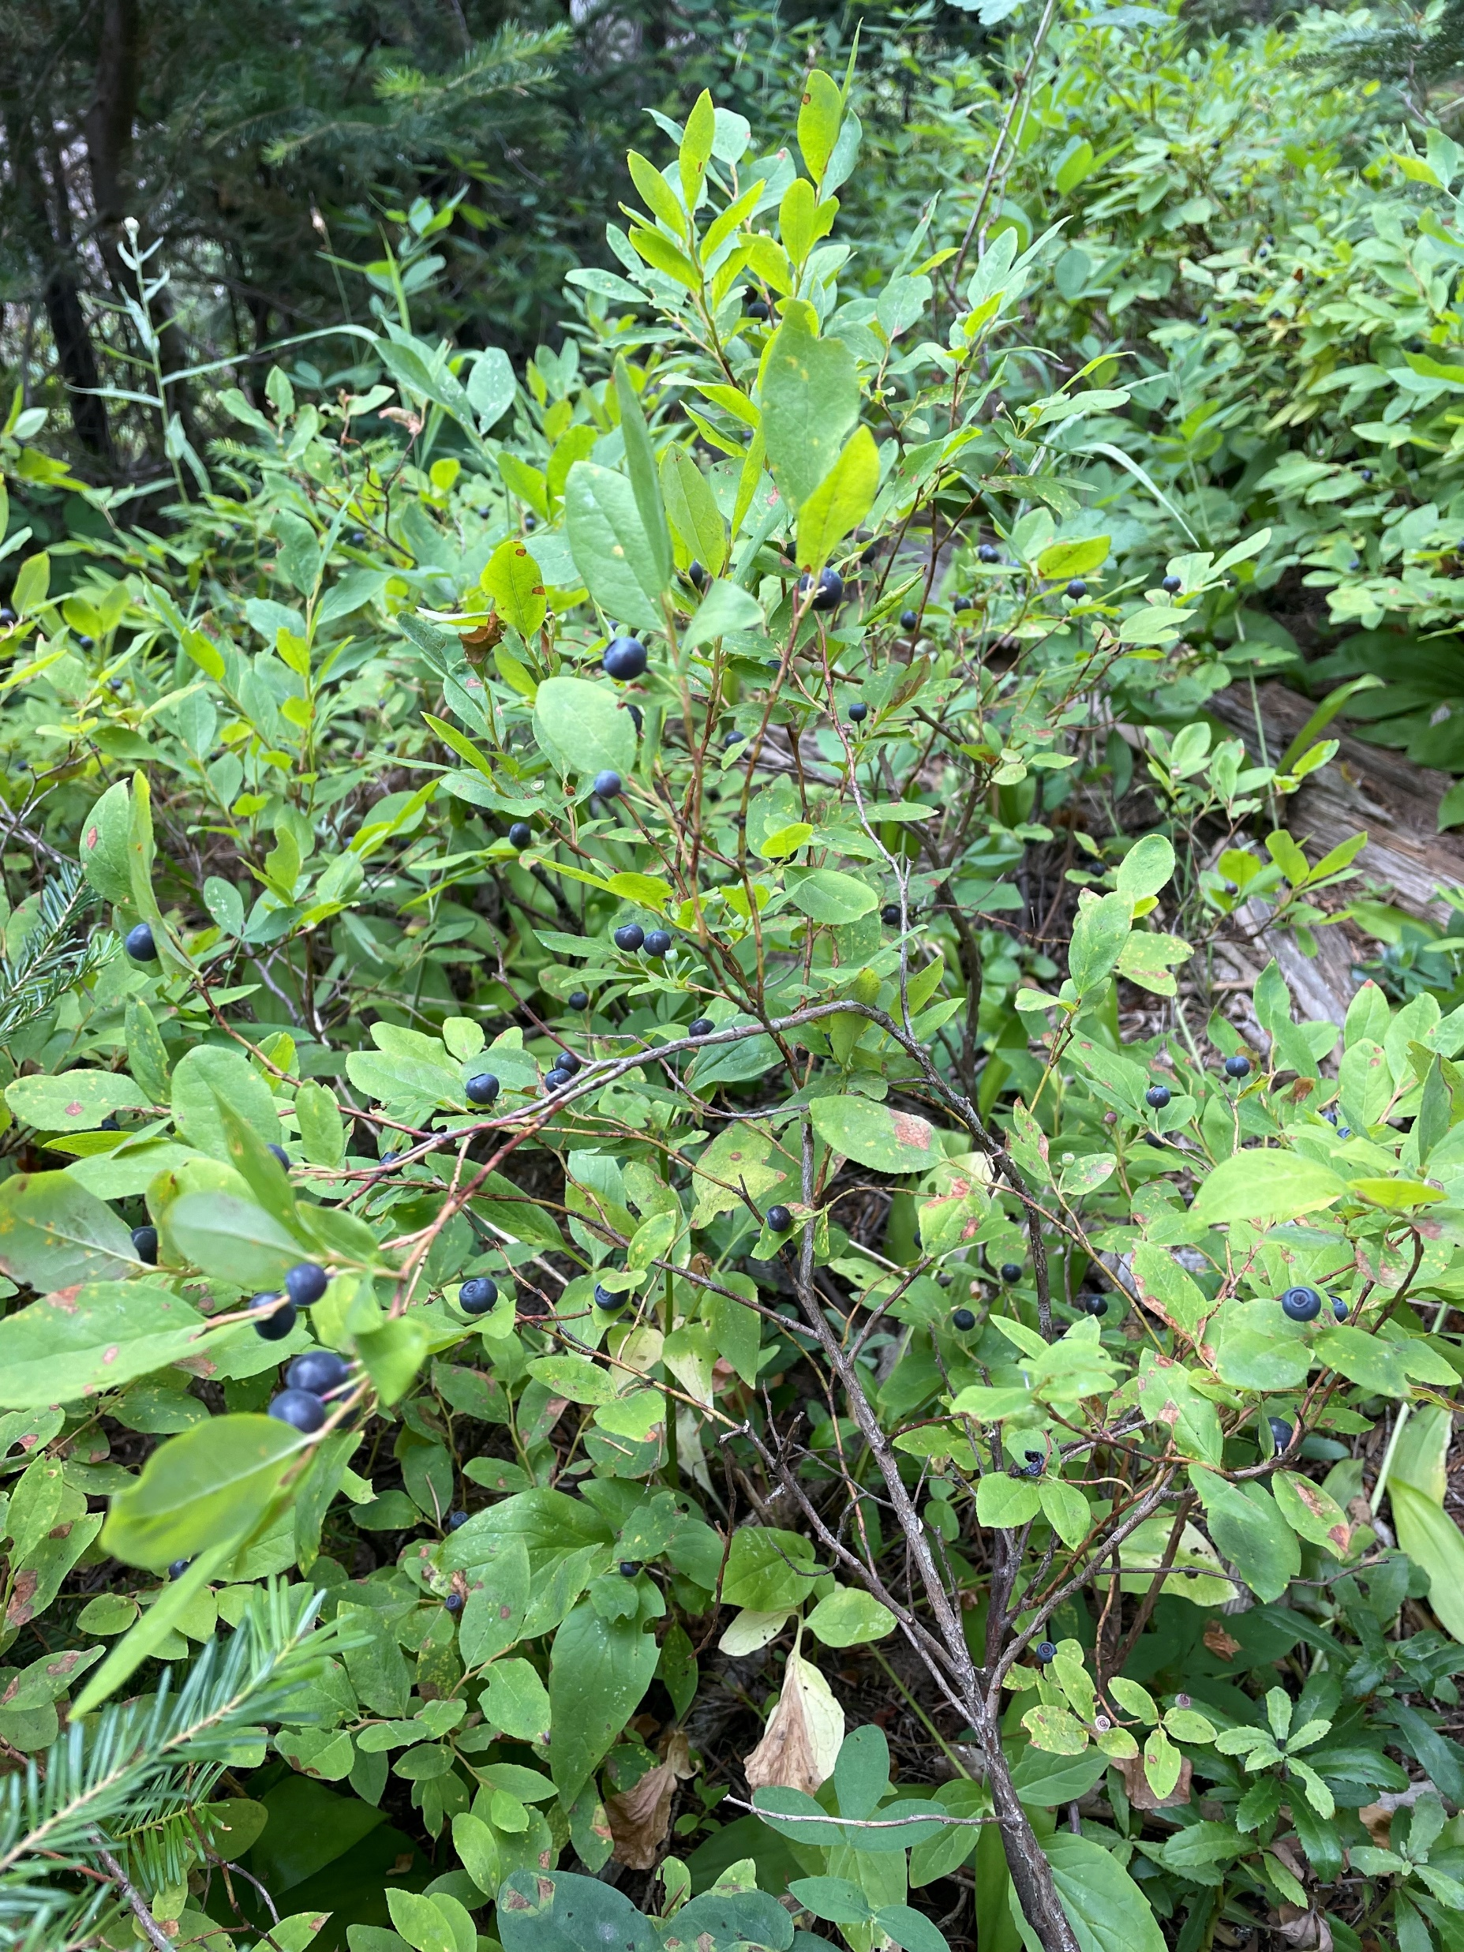
Traditional Ecological Knowledge
(TEK)
TEK is an evolving understanding and knowledge of practices passed from generation to generation.
TEK includes an “understanding of the relationships between people, plants, animals, natural phenomena, landscapes, and timing of events for activities such as hunting, fishing, trapping, agriculture, and forestry.”
Wild huckleberry- Oregon
Notes:
Photo Credit: N. Sirovatka USDA-NRCS

Slide 18
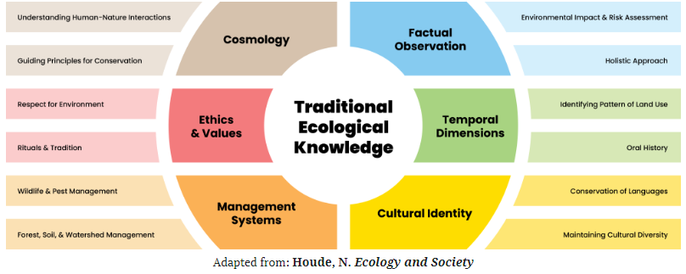
TEK is farther reaching than land management principles
Notes:
Global Center for Climate Justice (climatejusticecenter.org)- Traditional Ecological Knowledge and Climate Justice- Ben Whitaker August 25, 2022.
From the slide before, we know that TEK is greater than just focusing on natural resources.

Slide 19
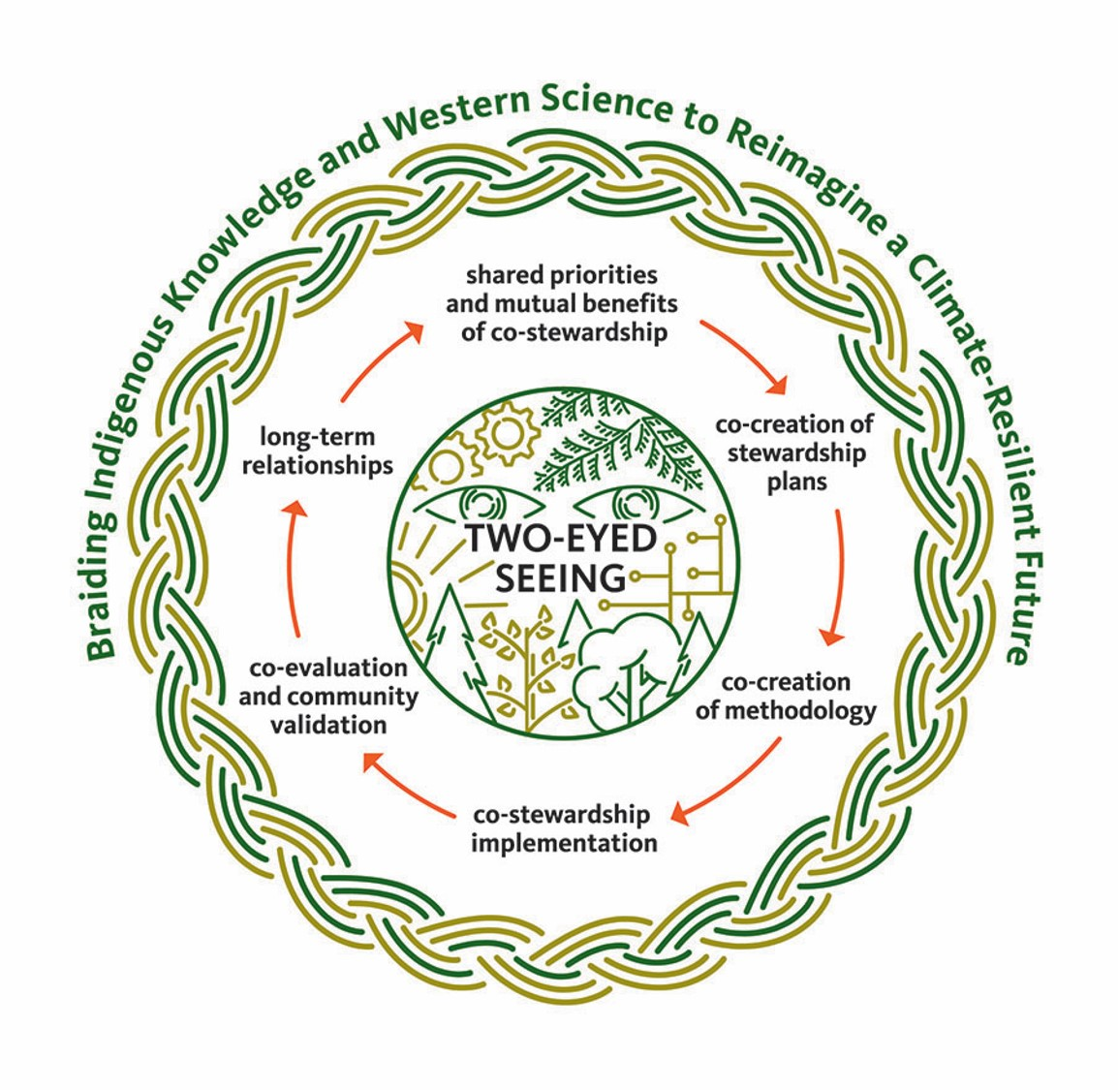
Sharing Ecological Knowledge involves listening, trust, and respect.
Graphic Credit: Oregon State University- College of Forestry-Traditional Ecological Knowledge Lab
Notes:
What is TEK? | Traditional Ecological Knowledge Lab (oregonstate.edu)
TEK lab at Oregon State University has multiple projects working with tribes. One includes tribal forest restoration and native seed collection.

Slide 20
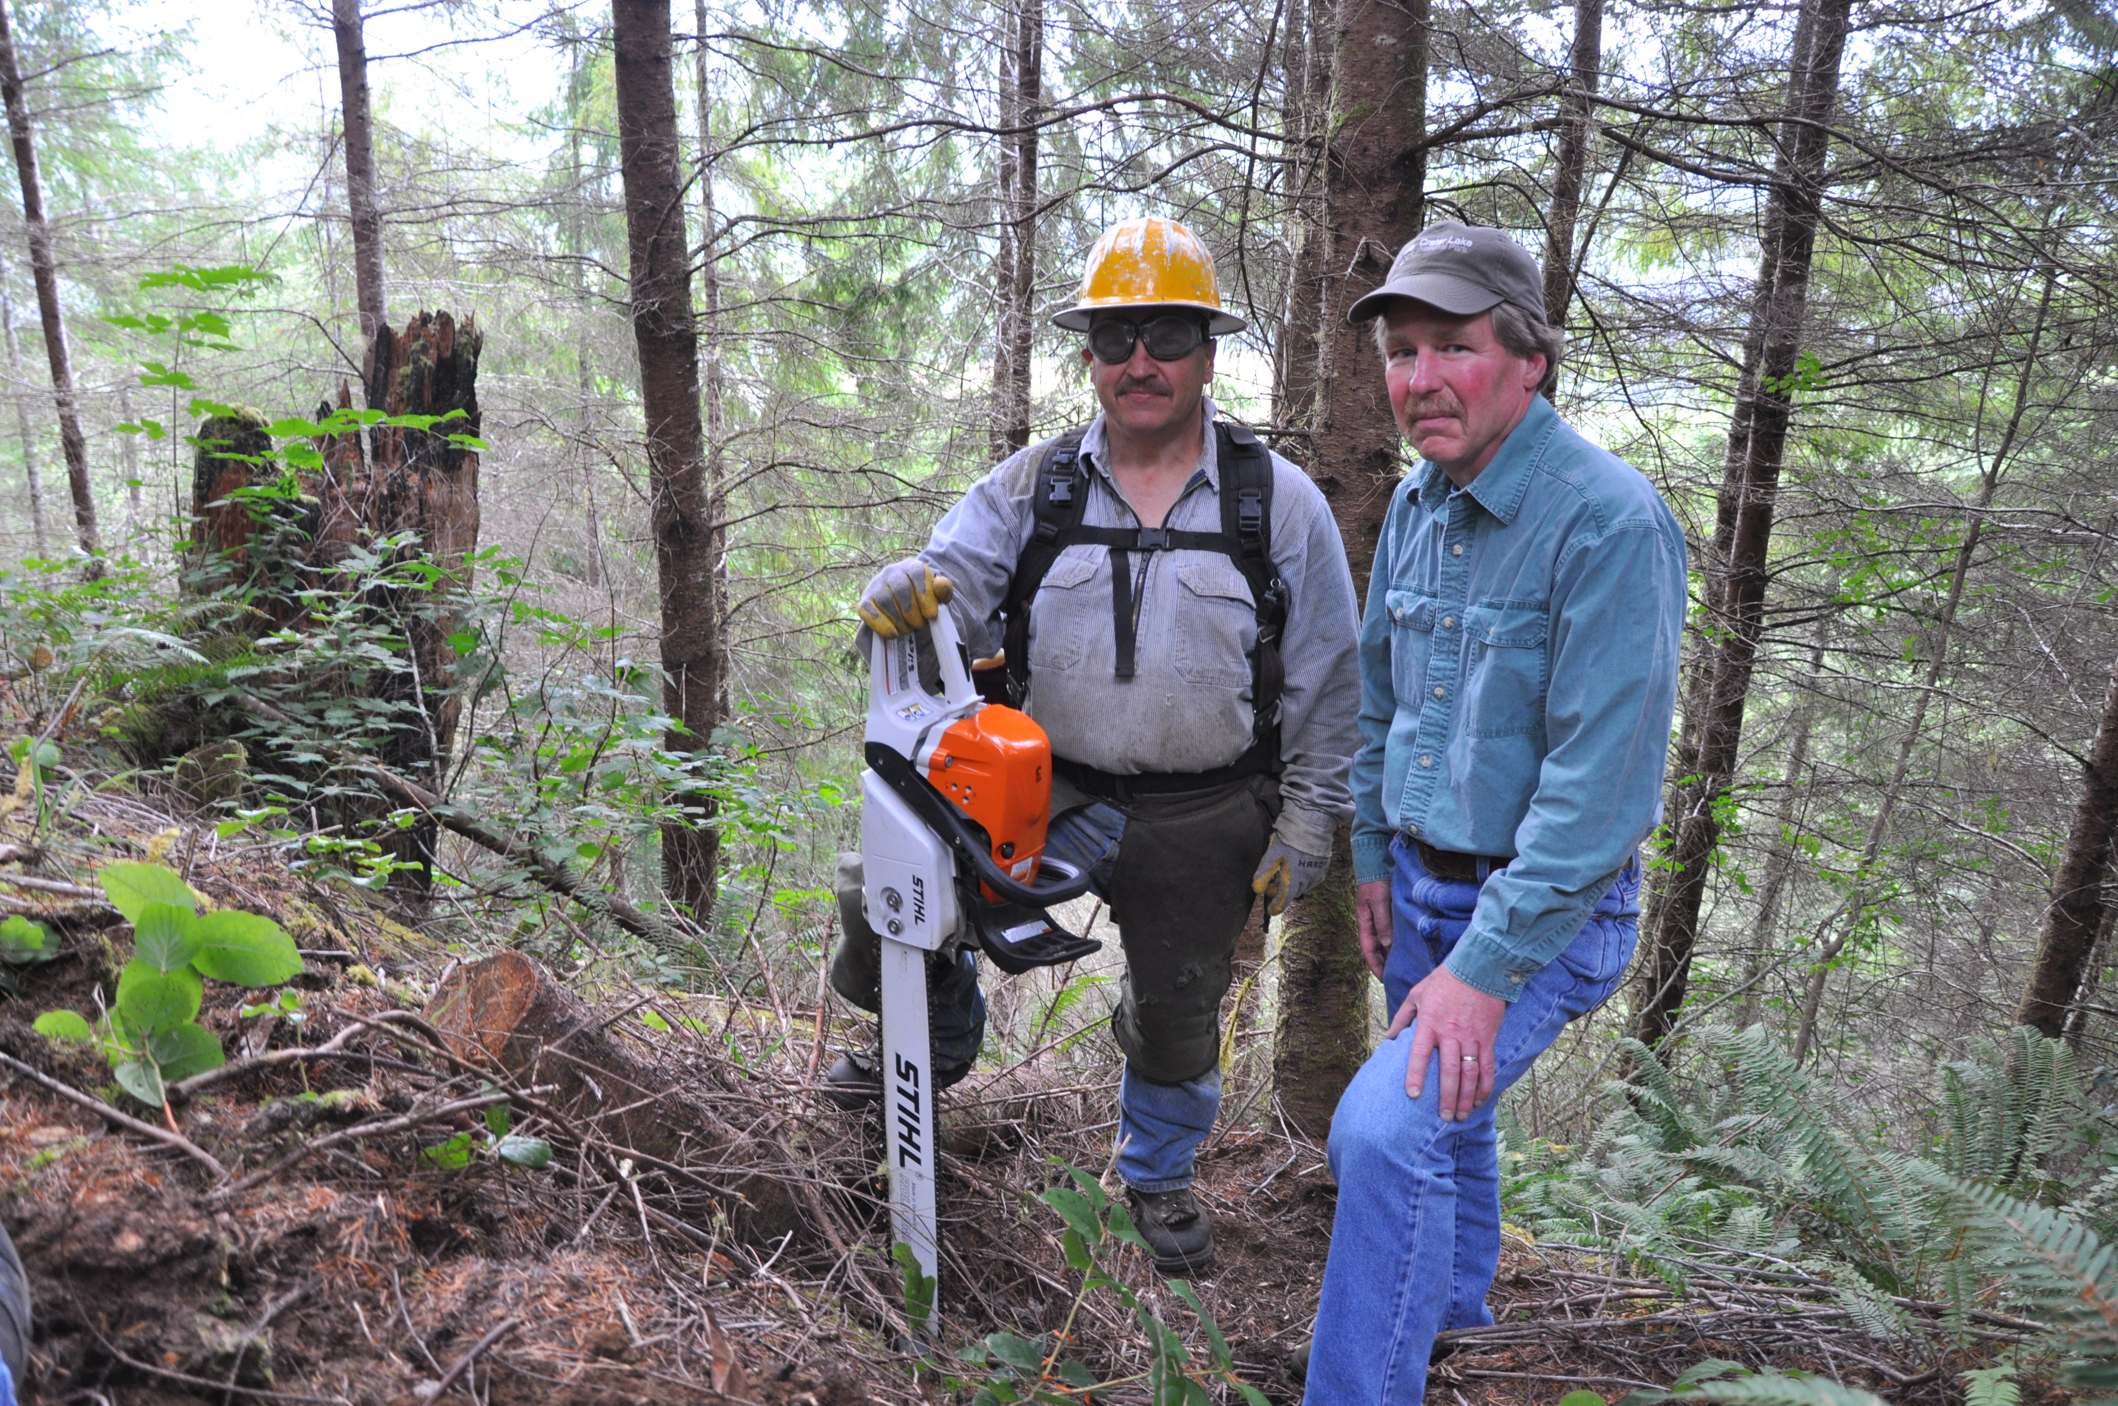
NRCS working with Tribes in Forestry
Above ground decisions affect below ground health
While a Pre-Commercial thin may look like a vegetative practice because soil and soil health is tied so tightly to plant health, an above ground treatment can provide benefits to the below ground ecosystem.
Potential to reduce soil erosion
Reduces wildfire risk
Allows for weak or unhealthy trees to be removed allowing healthy trees to flourish
More sunshine makes it to the under-story plants allowing for diversity and habitat.
Members of the Natural Resource Department for
The Confederated Tribes of the Siletz Indians-Oregon.
Tracy Robillard- USDA-NRCS
Notes:
(L) Kevin Goodell-Confederated Tribes of Siletz Indians
(R) Mike Kennedy- Natural Resource Director for Siletz Tribe
Photo: Tracy Robillard- USDA-NRCS

Slide 21

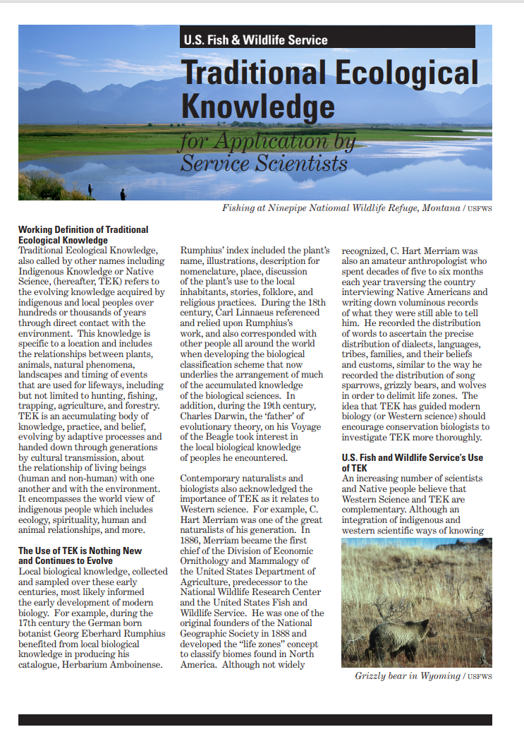
Forest management is one of the areas NRCS is looking to focus on with our Indigenous and Tribal Practices Team. Without encroaching on the cultural identity of our tribal partners, NRCS is looking to ensure that practice offerings which affect how a forest ecosystem functions, both above ground and below ground have consideration to TEK.
Other Federal Agencies including the U.S. Forest Service and the U.S. Fish and Wildlife Service are also evaluating the evolving knowledge from tribes and indigenous peoples in their operations.
Traditional Ecological Knowledge for Application by Service Scientists (fws.gov)
Notes:
Ask course participants how/if they utilize TEK in their planning considerations or activities.

Slide 22
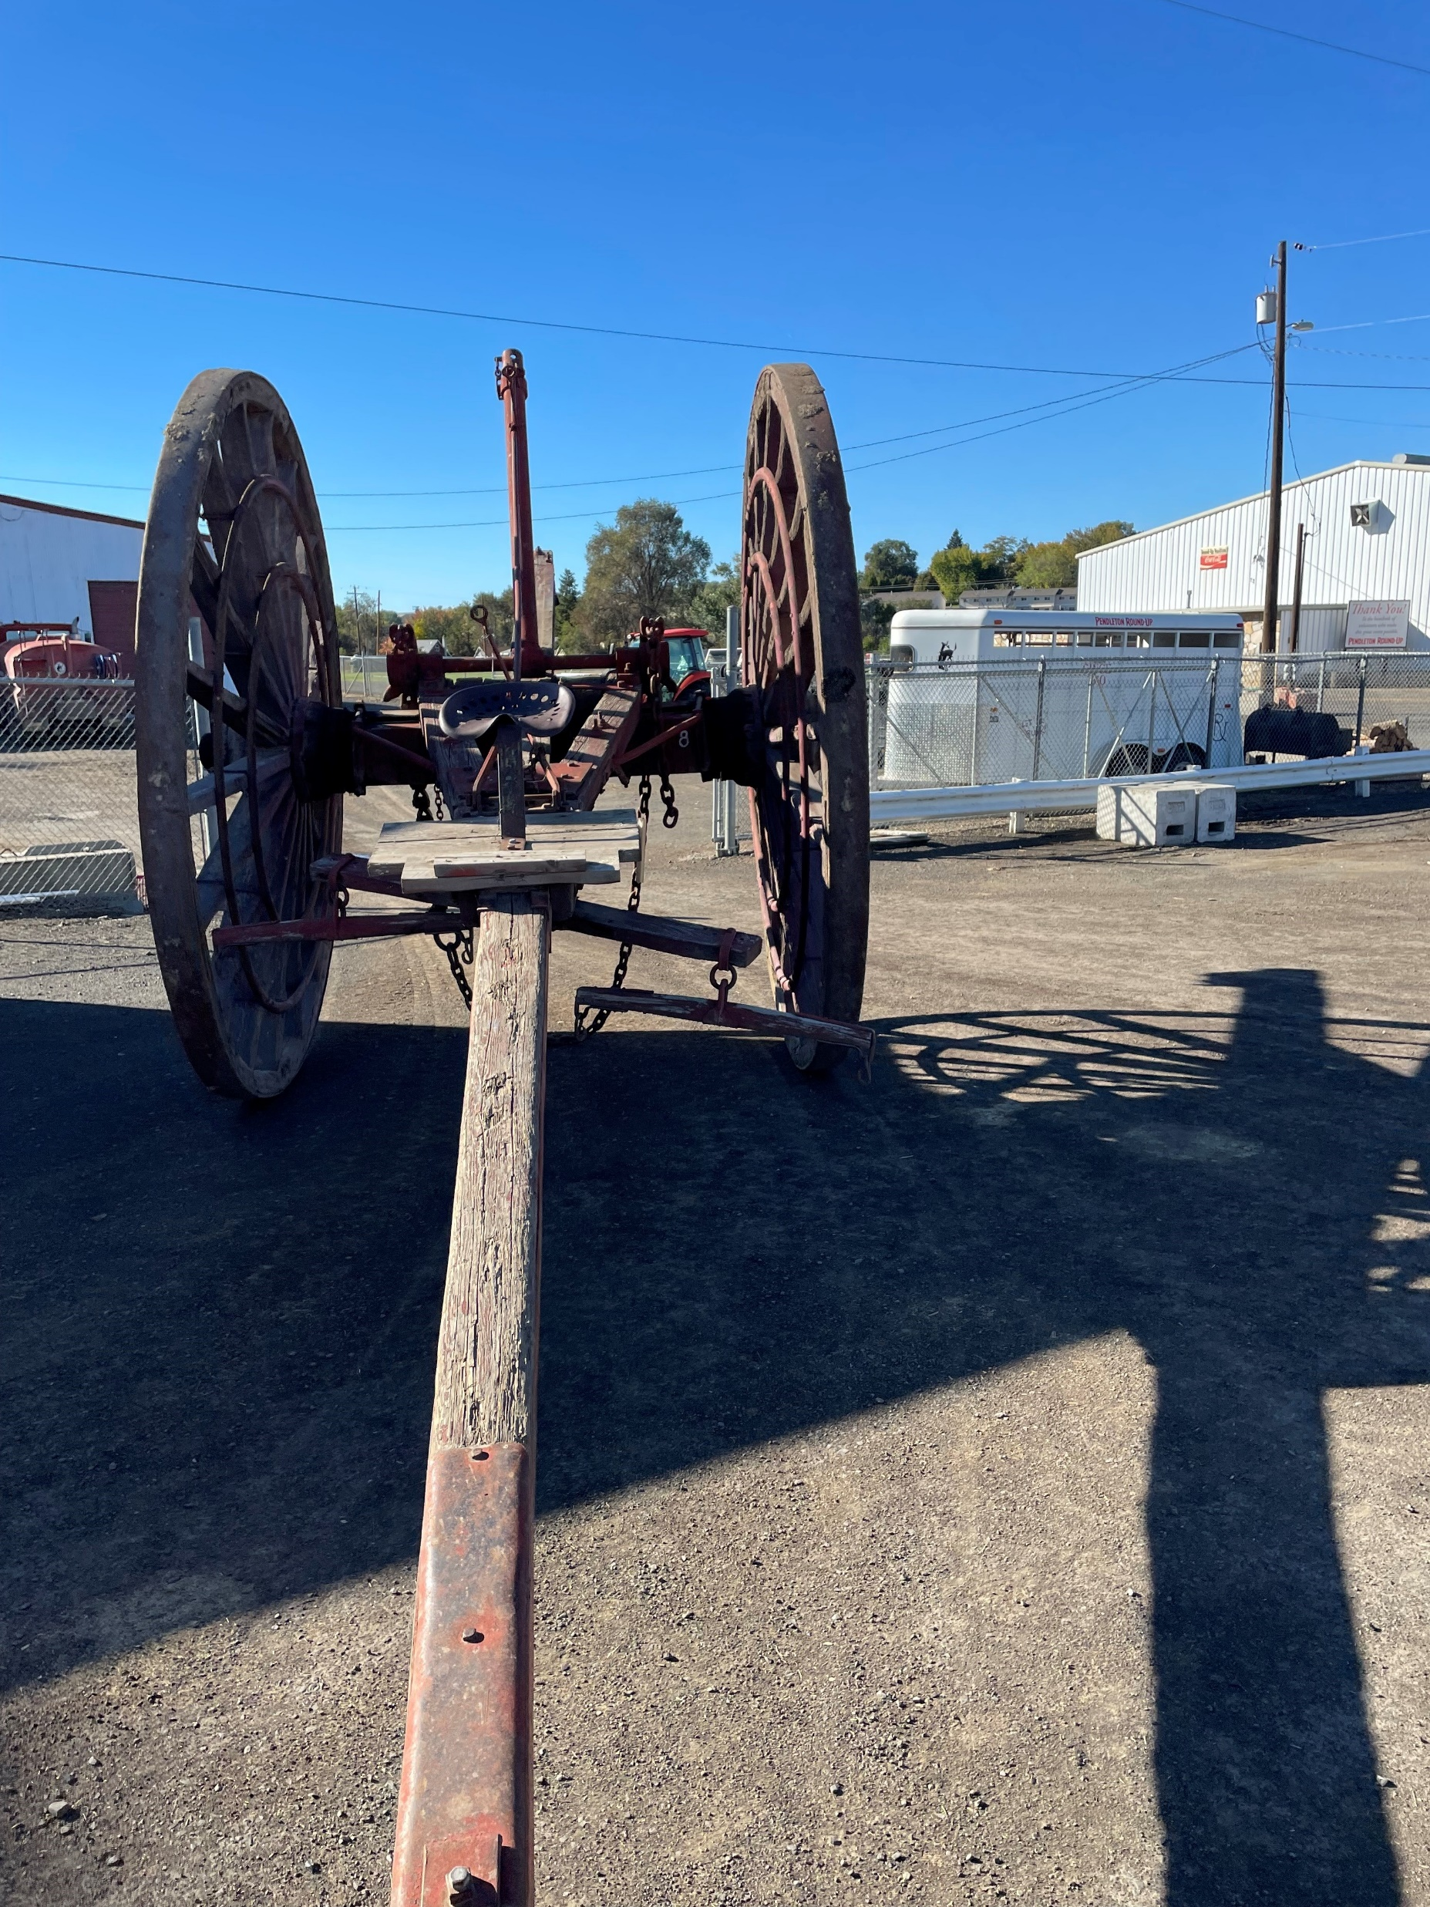
Local Ecological Knowledge (LEK)
Local Ecological Knowledge is gained from people with “strong social, cultural, and economic ties to forests.”
-Susan Charnley , A. Paige Fischer, and Eric T. Jones USDA- Forest Service
Common Sources of LEK
American Indians
Family Forest Owners
Non-commercial Timber Forest Product (NTFP) harvesters
Horse Drawn Log Arch
N. Sirovatka
Notes:
Traditional and Local Ecological Knowledge about Forest Biodiversity in the Pacific Northwest: General Technical Report PNW-GTR-751 April 2008
Photo Credit this slide: N. Sirovatka USDA-NRCS
LEK knowledge is important as many land managers make long standing management decisions based on handed down knowledge, just as TEK knowledge is handed down generation to generation.
With both TEK and LEK: Forestry decisions are long lasting and affect the land far into the future. Evolving knowledge understands that management doesn’t interfere with the “naturalness” of the forests, but rather that forests are better off because of the interventions.

Slide 23
Thank you!
For more information on Managing Soil Health,
visit us here:
https://www.nrcs.usda.gov/conservation-basics/natural-resource-concerns/soils/soil-health
USDA is an equal opportunity provider, employer, and lender.

